Slide 1
Bucket Sort Algorithm
NAME USN
Ms. Shivani V Banke 2GI20CS140
Ms. Shradha Mallikarjun Patil 2GI20CS144
Ms. Srushti B Mudennavar 2GI20CS158

Slide 2
Introduction
Bucket Sort is a sorting technique that works on an algorithm that takes an unsorted array as input and returns an array of sorted elements.
The working principle of bucket sort is to divide the given series of numbers into several buckets, sort the data in each bucket according to the requirement, and then merge the data again that outputs an array of sorted elements.

Slide 3
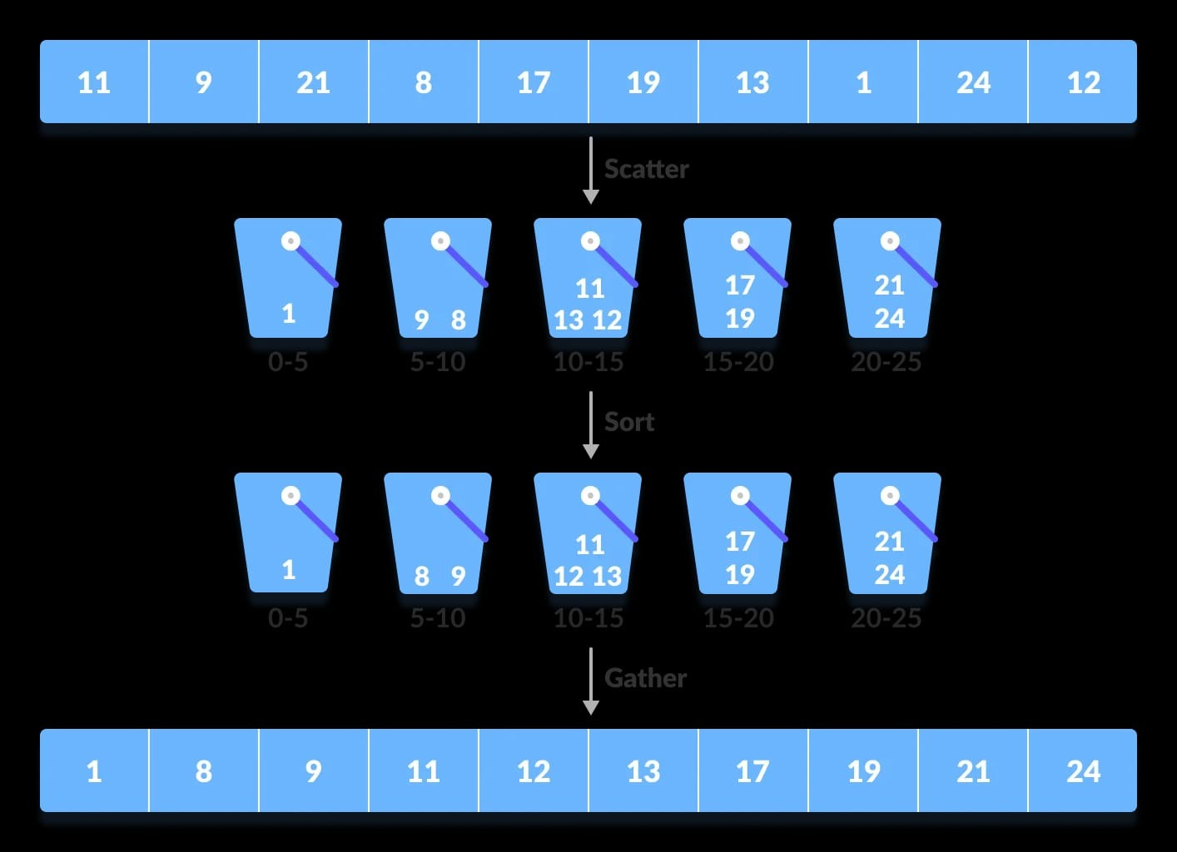
basic procedure of performing the bucket sort
First, partition the range into a fixed number of buckets.
Then, toss every element into its appropriate bucket.
After that, sort each bucket individually by applying a sorting algorithm.
And at last, concatenate all the sorted buckets.

Slide 4
Advantages and disadvantages of bucket sort
Advantages:
Bucket sort reduces the no. of comparisons.
It is asymptotically fast because of the uniform distribution of elements.
Disadvantages:
It is not useful if we have a large array because it increases the cost.
It is not an in-place sorting algorithm, because some extra space is required to sort the buckets.

Slide 5
Algorithm
For floating point values:
Bucket Sort(A[])
Let B[0...n-1] be a new array
n=length[A]
for i=0 to n-1
make B[i] an empty list
for i=1 to n do
insert A[i] into list B[n *a[i]]
for i=0 to n-1 do
sort list B[i] with insertion-sort
Concatenate lists B[0], B[1],........, B[n-1] together in order
End

Slide 6
Let us take an input array of 7 elements.
The input array is:
0.54 | 0.44 | 0.45 | 0.64 | 0.49 | 0.59 | 0.10
Create an empty array of size 10, as shown below. Each slot of this list or array is to use as a bucket for storing elements.
0 | 0 | 0 | 0 | 0 | 0 | 0 | 0 | 0 | 0

Slide 7
To insert elements in the respective buckets, follow the following three steps:
Let us take an element from the input array as an example that is 0.54
Multiply it by the size of the empty array(size = 10) and convert the result to an integer using int(). You will get:
0.54 × 10 = 5.4
On converting it to integer, we get, int (5.4) = 5
Finally, 5.4 is inserted into bucket-5
0.54 | 0.44 | 0.45 | 0.64 | 0.49 | 0.59 | 0.10
0 | 0 | 0 | 0 | 0 | 0.54 0.59 | 0 | 0 | 0 | 0

Slide 8
Similarly, 0.59 is also inserted into the same bucket, bucket-5, because the two elements’ floor value is equal.
The above process continues until all the elements settle in their respective buckets.
0.10 | 0 | 0 | 0 | 0.44 0.45 0.49 | 0.54 0.59 | 0.64 | 0 | 0 | 0
The elements of each bucket are then sorted using any of the algorithm techniques.
0.10 | 0 | 0 | 0 | 0.44 0.45 0.49 | 0.54 0.59 | 0.64 | 0 | 0 | 0

Slide 9
Finally, the elements from the buckets have been gathered by passing the elements into the original array by iteration.
0.10 | 0.44 | 0.45 | 0.49 | 0.54 | 0.59 | 0.64

Slide 10
Algorithm
For integer values
Step1-Take input array find the MAX number in the array
Step2-Define 10 queues each representing bucket for each digit from
0to9.
Step3-Consider the least significant digit of each number in the
list which is to be sorted.
Step4-Insert each number into their respective queue based on the
least significant digit.

Slide 11
Algorithm
Step5-Group all the numbers from queue0to queue9in the order
they have inserted into their respective queues.
Step 6- Repeat from step3based on the next least significant digit.
Step7-Repeat from step2until all the numbers are grouped
based on the most significant digit.

Slide 12
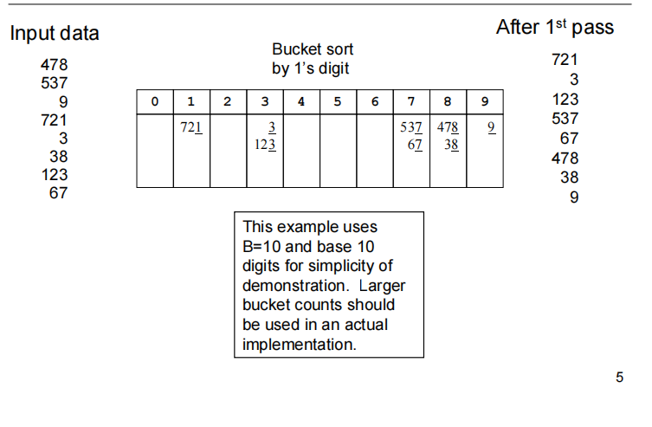

Slide 13
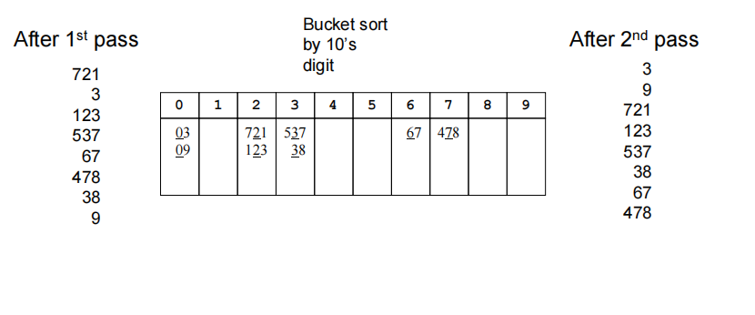

Slide 14
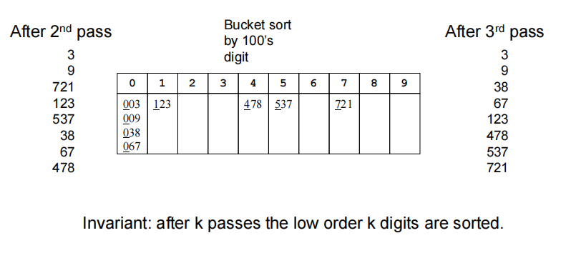

Slide 15
Analysis and Performance:
Best Case Time Complexity: O(n+k)
Average Case Time Complexity: O(n+k)
Worst Case Time Complexity: O(n^2)

Slide 16
Applications of bucket sort
The contact list in your phone is sorted, which means you can easily access your desired contact from your phone since the data is arranged in that manner for you. In other words, “it is sorted”.
While shopping on flip kart or amazon, you sort items based on your choice, that is, price low to high or high to low.

Slide 17
Conclusion:
The bucket Sort algorithm sorts the elements of the array by first segregating the array into a number of buckets, sorting each bucket, and then gathering the elements back to form the sorted array.
Bucket Sort is used to sort an array where elements are uniformly distributed, or where the elements of the array range between 0 and 1.
Bucket sort can exhibit the best case time complexity of O(n+k), where n is the number of buckets and k is the bucket size.
The way buckets are provided ranges differ in cases when the elements of the array are floats and integers. This is discussed in detail above.

